Slide 1

E-MENU SYSTEM
Developed by:-

Slide 2
Wow your customers with vivid, interactive digital menus with mouth-watering food images, view item descriptions, contact waiters and chefs, rate their meal and service levels.
Your staff can focus on making the customers' experience a memorable one!​

Slide 3
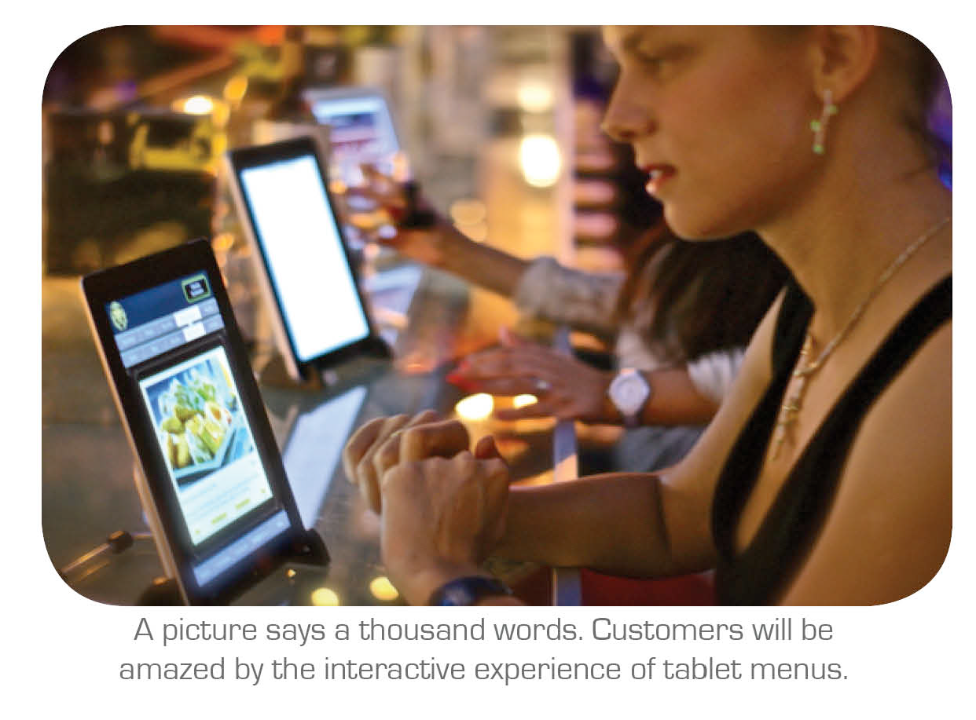

Slide 4
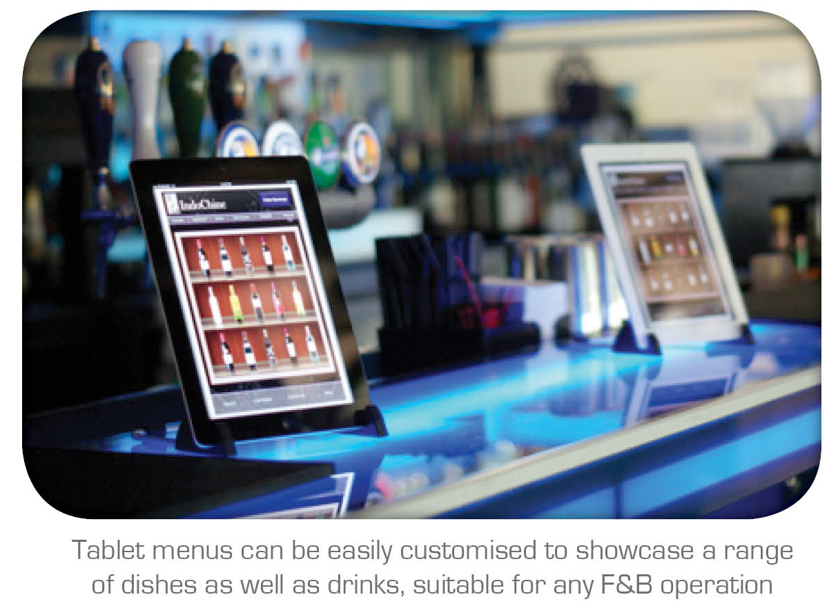

Slide 5
Functionality Provided
Customer
Admin
Kitchen

Slide 6
COSTUMER
Attractive & User Friendly Interface
Demo for how to use the system in the form of video
Description of the food items will be provided
Take Virtual Tour of the Resort at any time during Order
“Ring a Bell” - click to call the waiter for assistance
Specification like Jain food etc can be provided by the costumer
Once user Confirms the order it cannot be updated by the costumer

Slide 7
ADMIN
Print Bill of engaged table
Update order in any table
Search bill by Bill No
Search any days sale
Discount (if any)
Add item
Update price
Delete item

Slide 8
KITCHEN
Bold & Clear Display of Order
Dispatch Order as it is prepared
Quick Orders for fast delivery
Automatic Update of Orders
View Orders In-Process & Orders Pending in Q
Timeline of the Orders

Slide 9
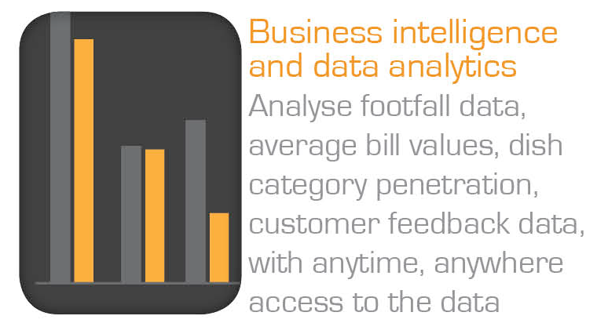

Slide 10
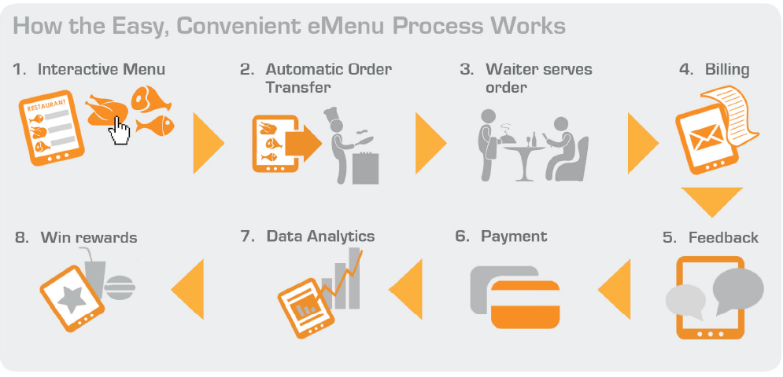

Slide 11
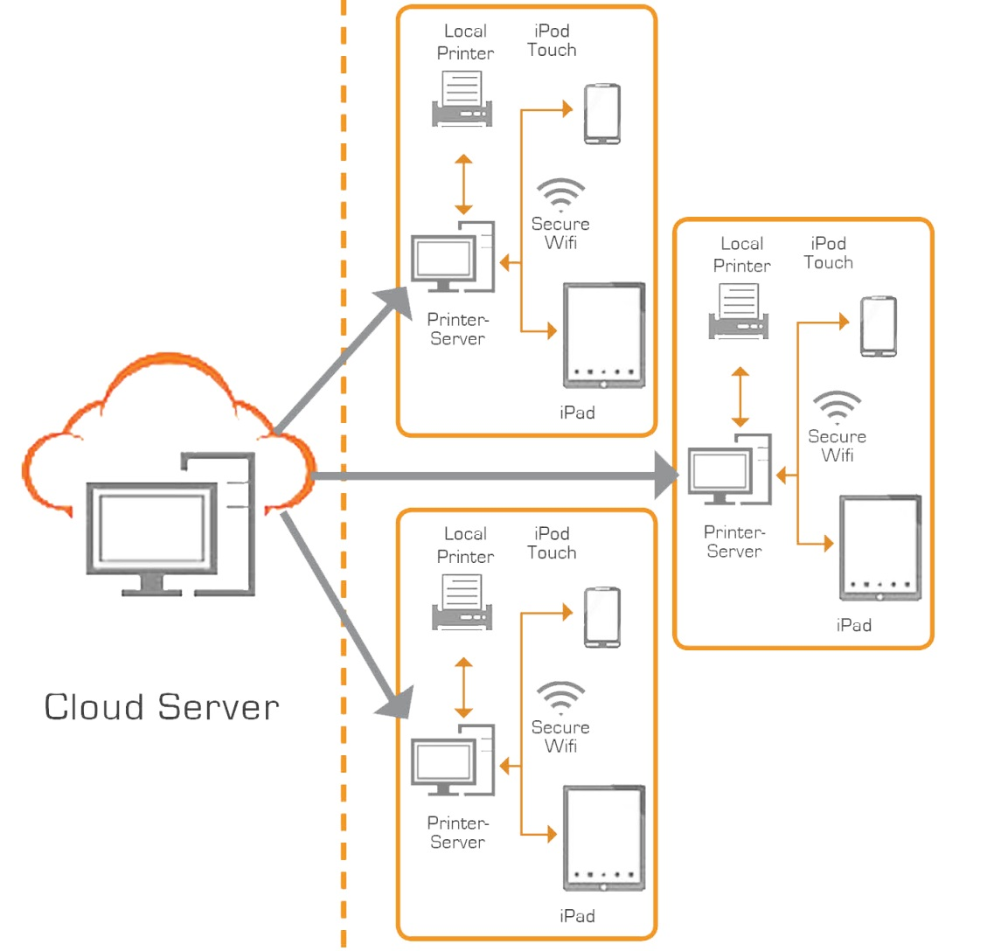

Slide 12
LETS HAVE A DEMO OF OUR SYSTEM !!!

